Slide 1

Plan to Explore

Slide 2
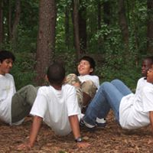
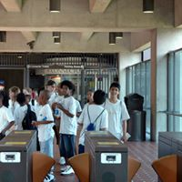
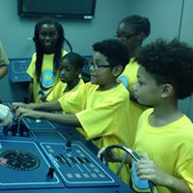
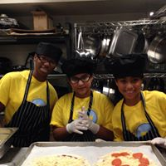
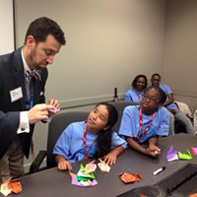
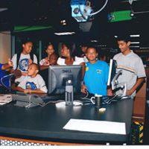
What Makes Us Different?
We specialize in helping the most underserved students see how what they learn in classroom experiences is relevant and necessary to achieving their own purpose.
Learning to work as a team at Adventure Links.
Navigating metro to explore life beyond the neighborhood.
We engage our Explorers in intriguing settings where they do what professions do and are inspired by the stories of their journeys.
Piloting a 360 degree sub simulator, USNA.
Planning meals with chefs from The Westin for The Westin Resort staff.
Our programs empower future influencers through hands-on career exploration and impactful education planning.
Practicing in purposeful planning with scientists at MITRE.
Engaging professionals in front of and behind the camera at NBC 4.

Slide 3
Our Core Work
Explorer Adventures ​(Young Explorers in grades 4-8) Interactive summer travel program that offers a behind-the-scenes look at some of the world’s most exciting careers | LIFE 101 (Mature Explorers in grades 9-12) Promotes the skills needed for gaining access to and attainment of post-high school education | Brayboy Scholars ​(Mature Explorers in grades 11-12) Intense search for and pursuit of applicable scholarships and assistance with all facets of the college application process

Slide 4
Testimonials
“We have fun and we don’t even know we’re learning!”
-Christopher (Age 10), Explorer 2016-present
“Great Explorations is making an impact in children’s lives.”
-Herbert Lavender, Explorer Grandparent 2014-present
“Don’t stop. We need you to offer more. This is awesome for our kids.”
-Lynda Techie-Menson, Explorer Parent 2014-present

Slide 5
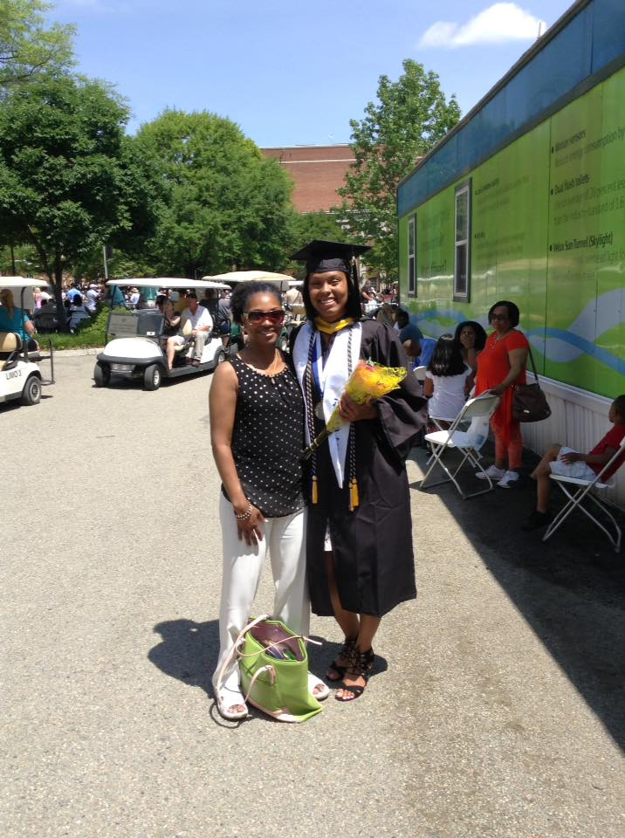





Testimonials
“I thank God for Great Explorations’ vision. It opened so many doors for Whitney.”
–Geraldine Price, Explorer Parent (2005-2009)
Whitney is a 2017 graduate of Longwood University with a major in Chemistry and minor in Biology. Learn more about Whitney’s journey. http://www.greatexplorations.us/explorer-spotlight.html
Celebrating Explorers in pursuit of education!

Slide 6
We’ve been inspired and supported by the best. Including…
The MITRE Corporation
Northern Virginia Community College-Woodbridge Campus
Reston Limousine
Georgetown Law Center
Ati Williams of HGTV’s DC Home Flippers
US Capital Police
General Counsel, P.C.
Dominion Foundation
NBC Washington
NBC Universal
Peter Van Buskirk with Best College Fit

Slide 7
Here’s what we know.
Education is the largest sustainable difference maker in changing the trajectory of a person’s life.
Workers with at least some postsecondary education now make up 65 percent of the total employment. Bachelor’s degree holders now earn 57 percent of all wages. “America’s Divided Recover: College Haves and Have Nots” from Georgetown Center on Education and the Workforce 2016
Engaging children in the work and life stories of professionals inspires imagination, makes their “impossible dreams” attainable, and drives them to take action toward their own passion.

Slide 8
We also know…
The parents in our Great Explorations community are faithful consumers who make purchases with their children in mind.
Explorer parents have 2 children on average with annual income of about $33,000. Reliable vehicles are necessary tools in their active lifestyles, particularly certified pre-owned vehicles.
Our work stretches our visibility in the DMV beyond our supporters and the families we serve to the vast number people we encounter just because of the nature of our travel.
We can provide Lindsay with an opportunity to both increase their customer base and participate in our life changing work in a unique way.

Slide 9
Great Explorations Star Lab Sponsorship Levels
$30,000 2 Partners | $20,000 2 Partners | $10,000 3 Partners | $5,000 6 Partners
1 Year Banner Title Partner: Banner to be displayed each time the Star Lab is used. | 1 year Banner display: Company’s name in Grande font and logo appearing in Partner window of banner. | 1 year Banner display: Company’s name appearing Super font in Partner window of banner. | 1 year Banner display: Company’s name appearing Average font in Partner window of banner.
2-Full day lab experiences anywhere in the continental US. (full-day =6 hours) | 1-Full day lab experience in a 300 mile radius of Washington, DC. (full day=6 hours) | 1-Half day lab experience in a 300 mile radius of Washington, DC. (half-day=3hours) | 1-Half day lab experience in a 300 mile radius of Washington, DC. (half-day=3hours)
Recognition in all print and radio media: The Star Lab experience is offered by Great Explorations and YOUR COMPANY. | Recognition in all print and radio media: The Star Lab experience is offered by Great Explorations and YOUR COMPANY. | Recognition in all print and radio media: The Star Lab experience is offered by Great Explorations and YOUR COMPANY. | Recognition in all print and radio media: The Star Lab experience is offered by Great Explorations and YOUR COMPANY.
Recognition on Great Explorations’ website with link to YOUR COMPANY. | Recognition on Great Explorations’ website with link to YOUR COMPANY. | Recognition on Great Explorations’ website with link to YOUR COMPANY. | Recognition on Great Explorations’ website with link to YOUR COMPANY.
Weekly social media highlight. | Weekly social media highlight. | Weekly social media highlight. | Weekly social media highlight.

Slide 10
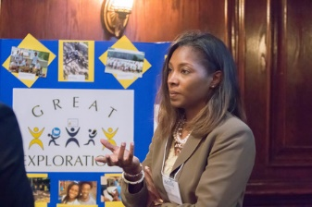
Meet the Founder…Jerylen Lavender Daniels
Jerylen has more than 20 years of experience in education as a teacher, administrator, and entrepreneur. She is an education development and learning excursion specialist. Jerylen left her position as assistant principal at Dale City Elementary in 2004 to run Great Explorations full-time.
To learn more about Great Explorations and discuss potential partnerships contact Jerylen Daniels at 571-237-9288. You can also visit www.greatexplorations.us.

